Slide 1
Generative AI for E-commerce & Retail Business
by Chris Raharja

Slide 2
Table of Contents
1 | Whom this course is intended for?
2 | AI tools & resources
3 | AI applications in E-commerce & retail business
4 | Generating product description with AI
5 | Building online store with AI
6 | Creating captivating product images with AI
7 | Designing product packaging with AI
8 | Generating marketing video with AI
9 | Building customer support chatbot with AI
10 | Conclusion & summary

Slide 3
Whom This Course is Intended for?
Entrepreneurs
Marketing Specialists
Brand Managers
Entrepreneurs, especially those who own e-commerce brands, and looking to enhance their knowledge about AI and its applications in E-commerce industry. Also, those who are interested in leveraging generative AI to improve their product offerings, marketing strategies, and overall customer experience.
Professionals responsible for creating and executing marketing strategies and looking to harness the power of generative AI. Also, those who are interested in using AI to develop personalized marketing campaigns, generate compelling content, and enhance overall marketing effectiveness.
Professionals managing brand strategy and identity, actively looking to leverage generative AI. Also, those who aim to utilize AI to create consistent and engaging brand assets, including product video and product packaging design

Slide 4
AI Tools & Resources
Embolden
Hocoos
Packify AI
https://www.embolden.co/
https://hocoos.com/
https://www.packify.ai/
Flair AI
Creatify AI
Best Chat
https://flair.ai/
https://creatify.ai/
https://www.bestchat.com/

Slide 5
AI Applications in E-Commerce & Retail Business
Product & Market Research
Product Recommendations
AI tools can analyze large datasets to identify market trends, customer preferences, and competitive landscapes, providing valuable insights for product development and strategic planning
AI Use Cases
AI algorithms can analyze customer behavior and preferences to provide highly personalized product suggestions, enhancing user experience and increasing sales
E-Commerce Website
Marketing & Customer Support
AI can build e-commerce websites by generating templates, organizing product listings, optimizing layout based on user behavior, and automatically creating SEO-optimized product descriptions for a user-friendly and search-friendly online store.
AI can significantly enhance marketing and customer support in e-commerce by automating the creation of engaging marketing videos and building effective customer support chatbots

Slide 6
Generating Product Description with AI
Copy AI
Embolden
https://www.copy.ai/
https://www.embolden.co/

Slide 7
Building Online Store with AI
https://hocoos.com/
https://www.wix.com/
https://10web.io/

Slide 8
Creating Captivating Product Images with AI
https://flair.ai/
https://www.delete.bg/aistudio/

Slide 9
Designing Product Packaging with AI
Spring
Packify AI
https://spring.sourceful.com/
https://www.packify.ai/

Slide 10
Creating Marketing Videos & Ad Copy with AI
https://creatify.ai/
https://studio.oxolo.com/
https://glato.ai/
https://copygenius.io/

Slide 11
Building 3D Virtual Store
https://odyssey3d.io/

Slide 12

Building Customer Support & Product Recommendation Chatbot with AI
https://www.bestchat.com/
https://www.browsebuddy.ai/

Slide 13
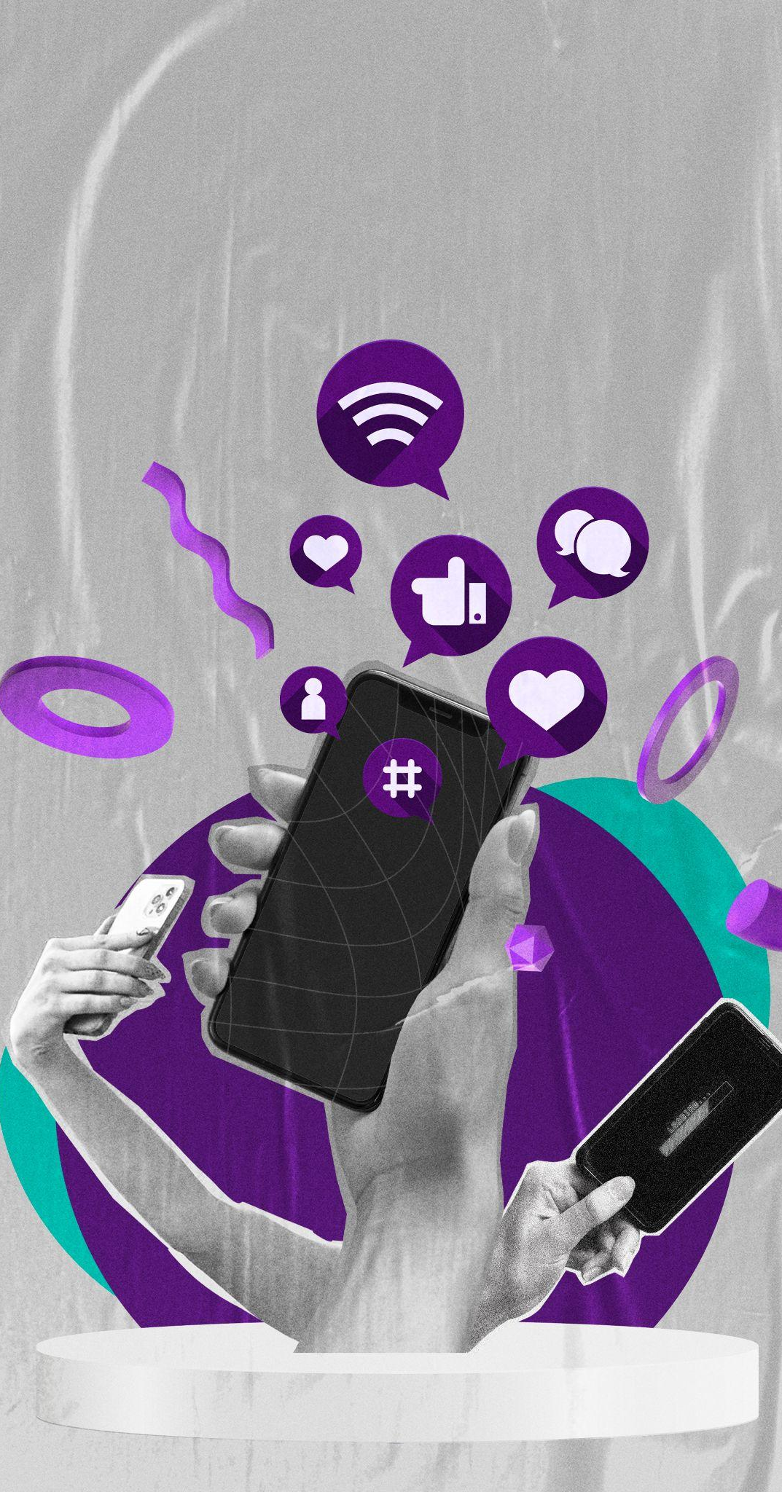
Product Research & Market Research with AI
Analyzing Sales Report with AI
https://www.perplexity.ai/
https://julius.ai/

Slide 14
Conclusion & Summary
Test Different Prices
Customer Segmentation
Evaluating Conversion Rate
Strong Brand Identity
Experiment with various pricing models and discounts for different customer segments or over different time periods. Analyzes the impact on sales and profit margins to identify the most effective pricing strategy for your products.
Segment your customers based on demographics, purchase behavior, and preferences. Tailor marketing campaigns and product offerings to each segment to increase relevance and engagement.
Continuously monitor and analyze conversion rates to identify trends and areas for improvement. Use analytics tools to track user behavior and adjust strategies to enhance the effectiveness of your sales funnel.
Develop a memorable brand identity that resonates with your target audience. Consistent branding across your website, social media, and marketing materials can build trust and differentiate your business from other competitors.

Slide 15
Thank You

